Slide 1
PREDICTIVE ANALYSIS – WHAT & WHY

Slide 2
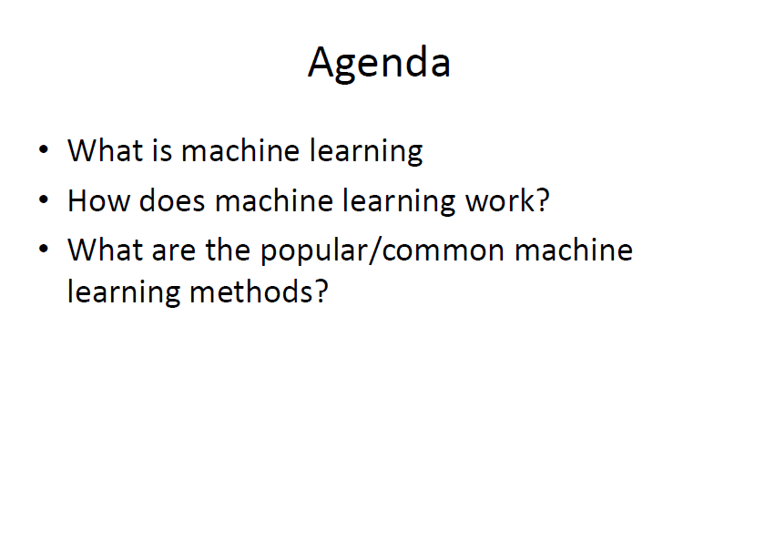

Slide 3
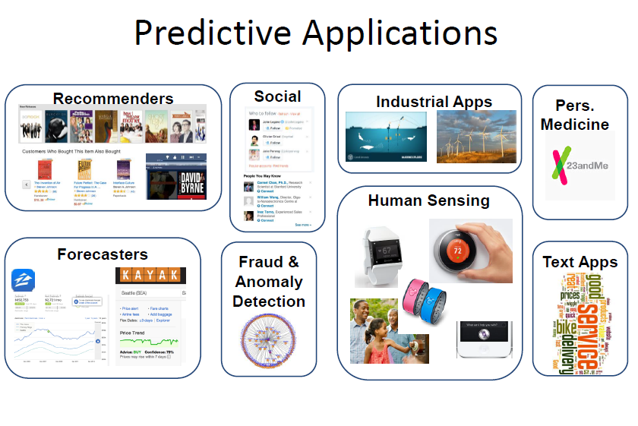

Slide 4
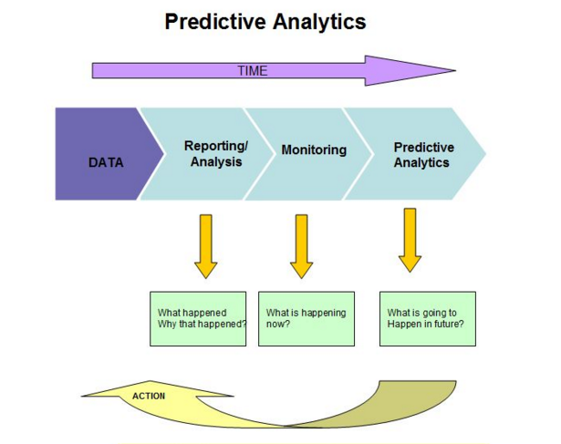
Prescriptive Analysis

Slide 5
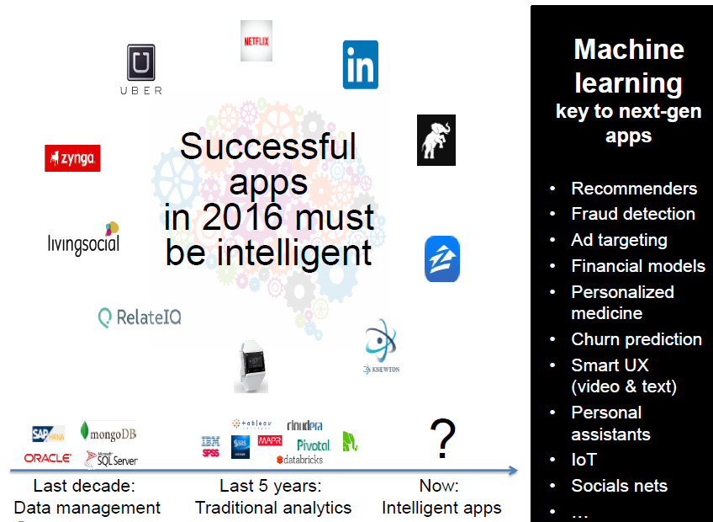

Slide 6
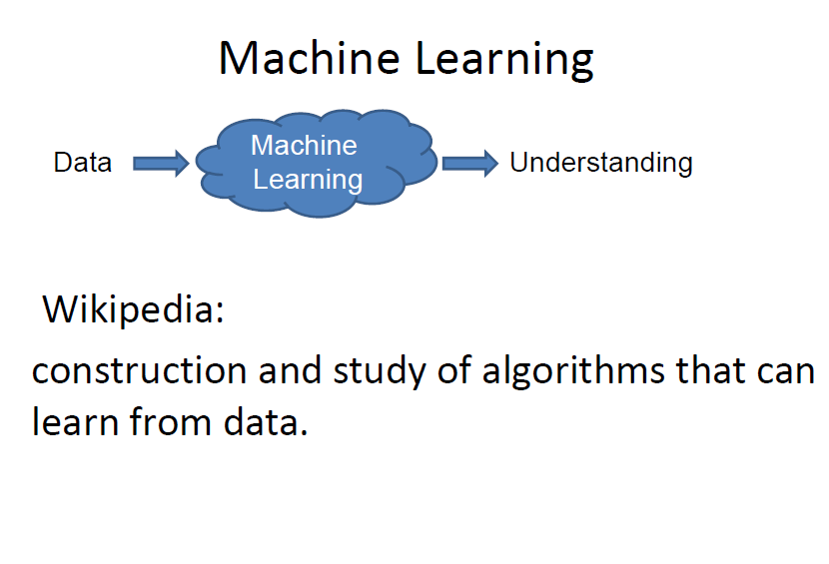

Slide 7
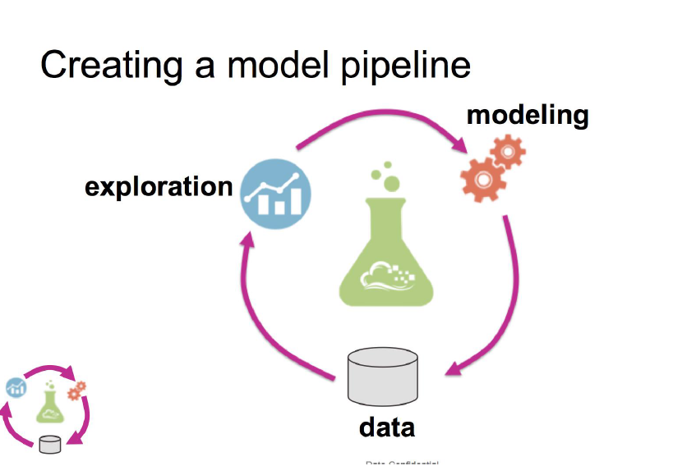

Slide 8
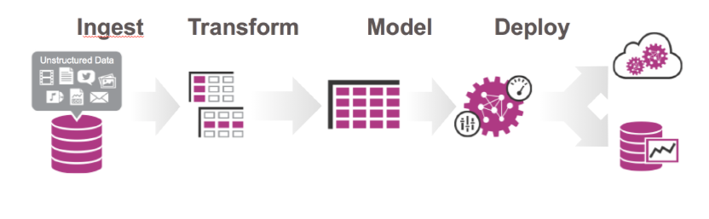
CREATING A MODEL PIPELINE

Slide 9
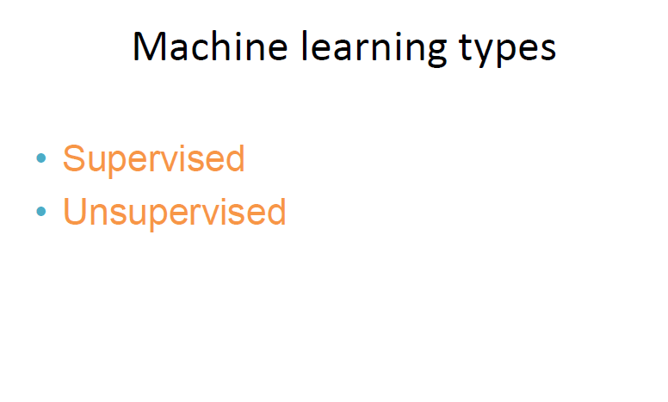

Slide 10
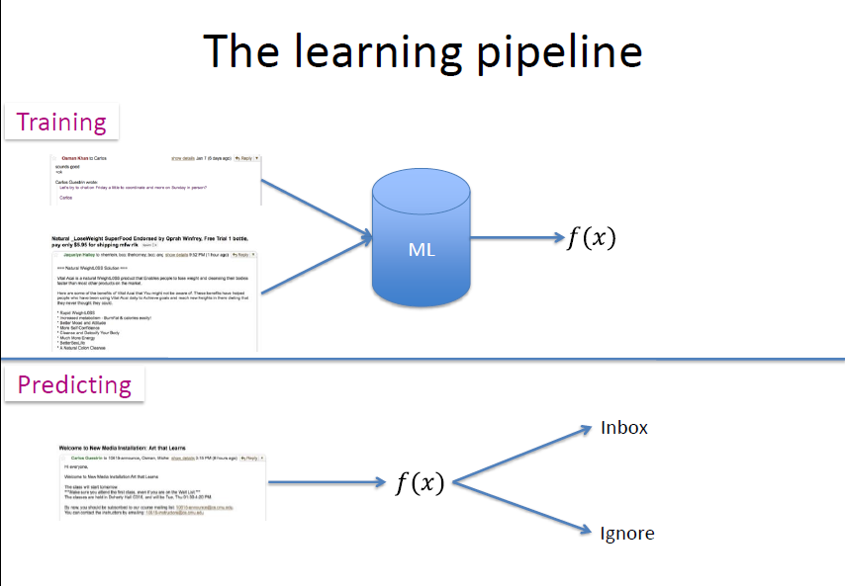

Slide 11
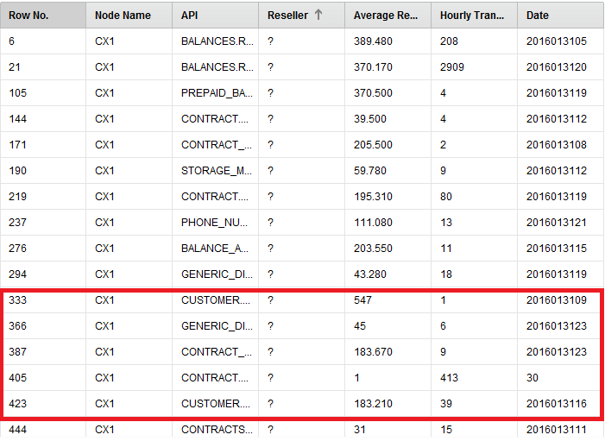
RAPIDMINER - EXAMPLE

Slide 12
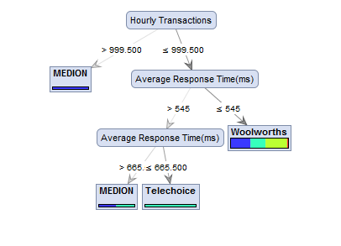
DECISION TREE

Slide 13
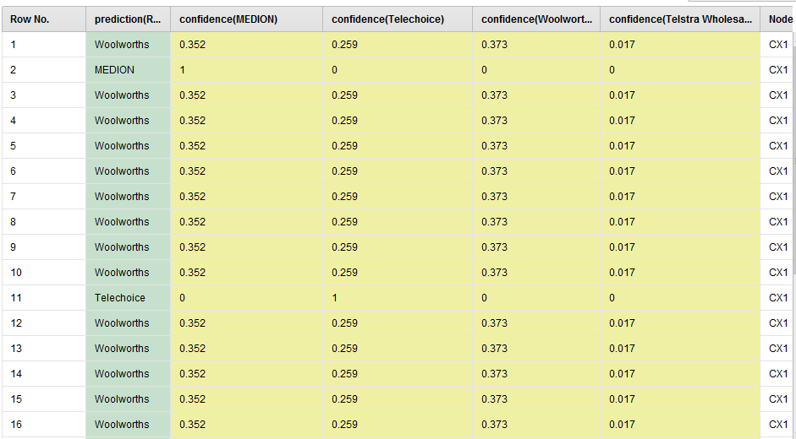
OUTPUT - CONFIDENCE

Slide 14
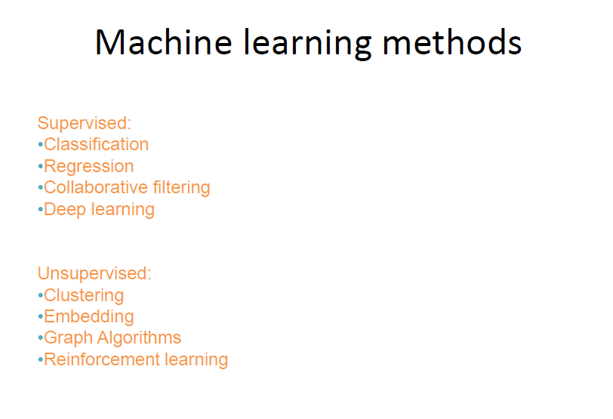

Slide 15
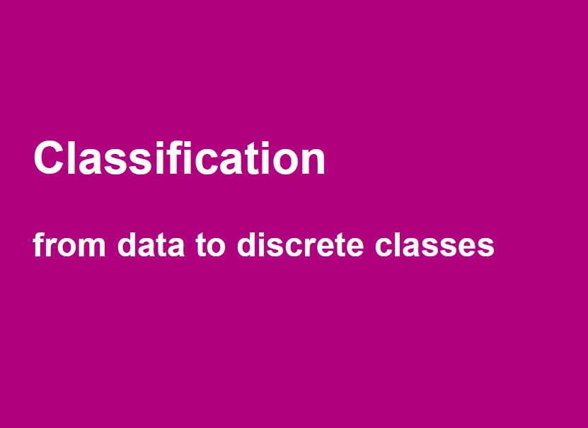

Slide 16
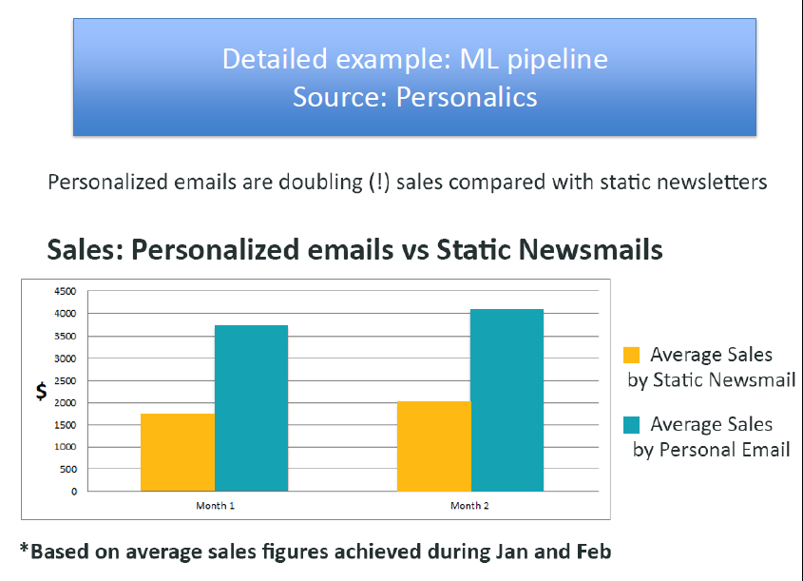

Slide 17
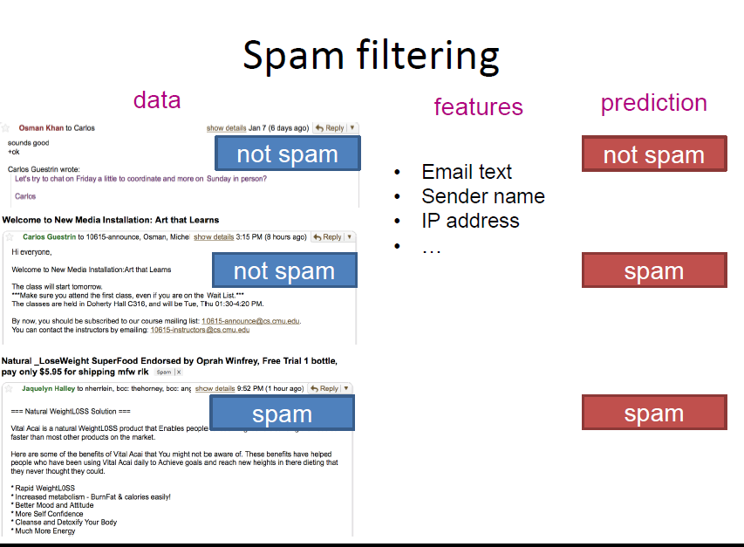

Slide 18
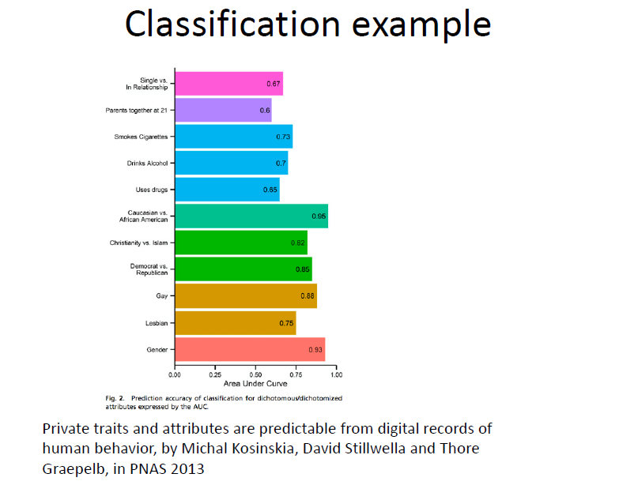

Slide 19
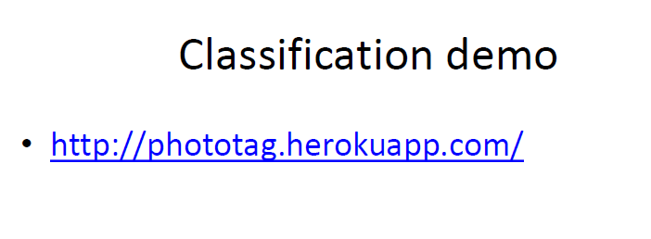

Slide 20
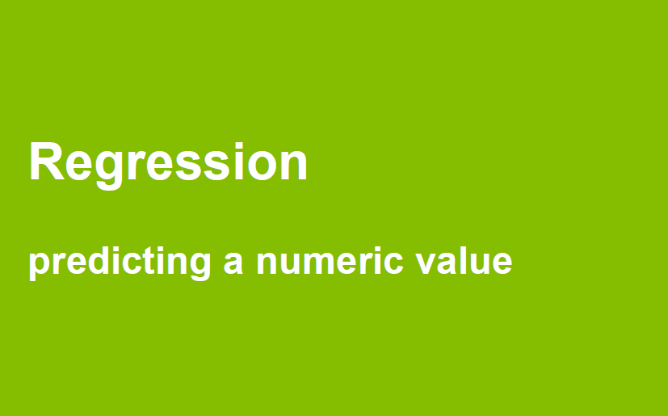

Slide 21
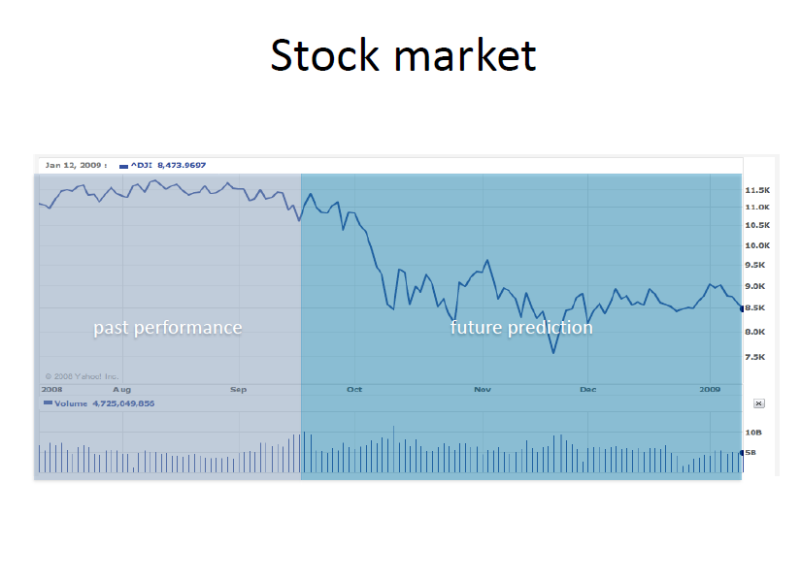

Slide 22
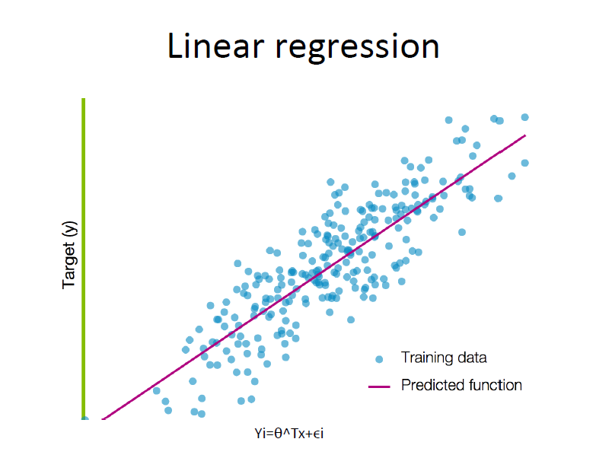

Slide 23

sentifier.s3-website-us-west-2.amazonaws.com/index.html

Slide 24


Slide 25
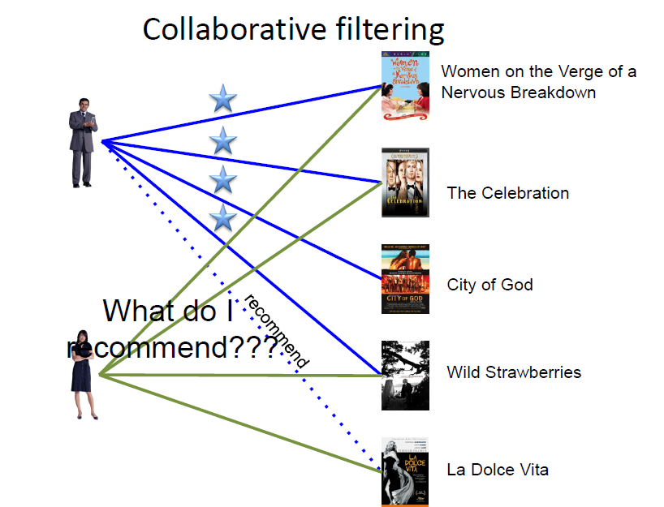

Slide 26

http://pathways-demoherokuapp.com

Slide 27


Slide 28
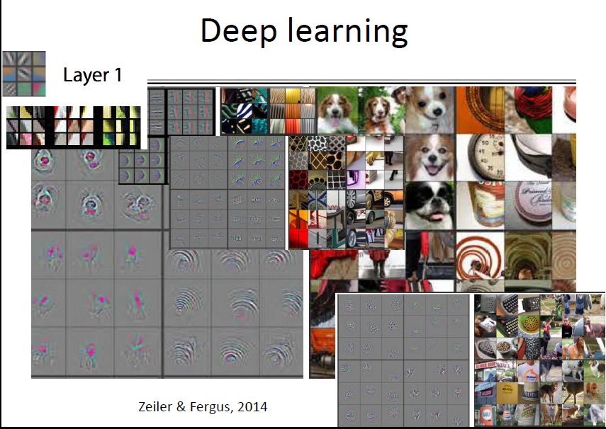

Slide 29
Deep Learning example
http://bickson.blogspot.co.il/2015/11/deepartio-deep-learning-for-art.html
https://deepart.io/

Slide 30
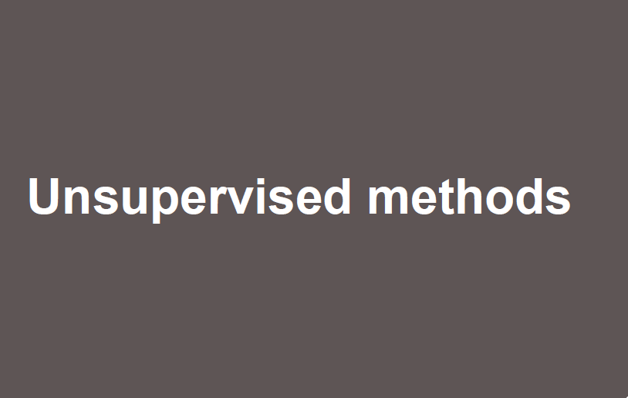

Slide 31
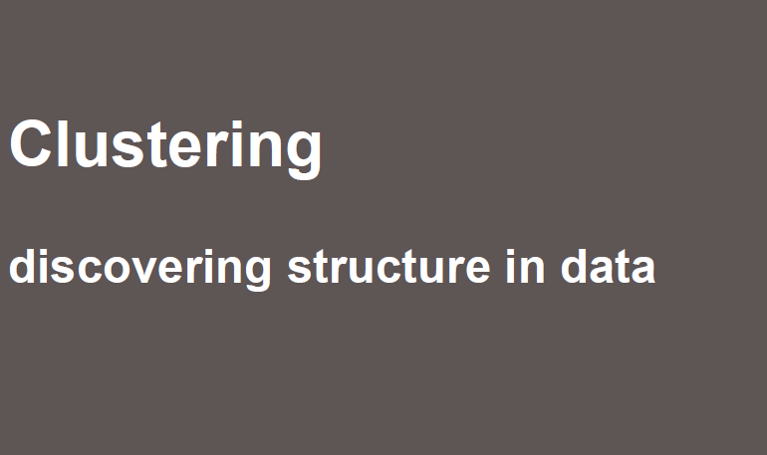

Slide 32
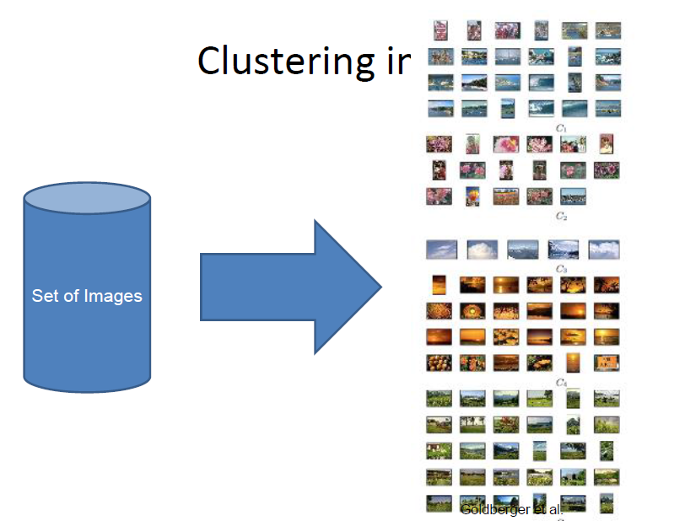

Slide 33
Example
fresh-image.s3-website-us-west-2.amazonaws.com

Slide 34
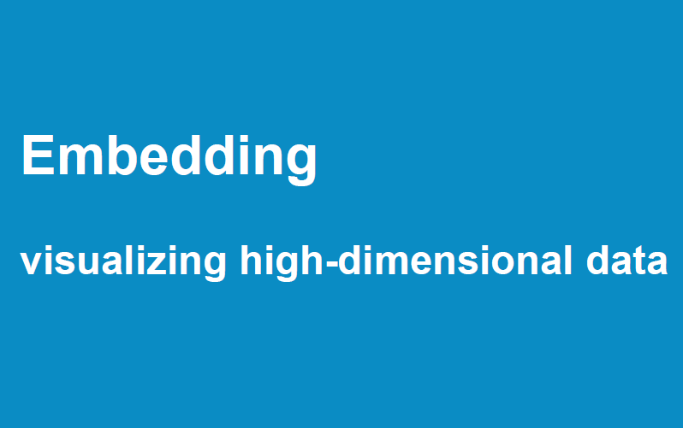

Slide 35
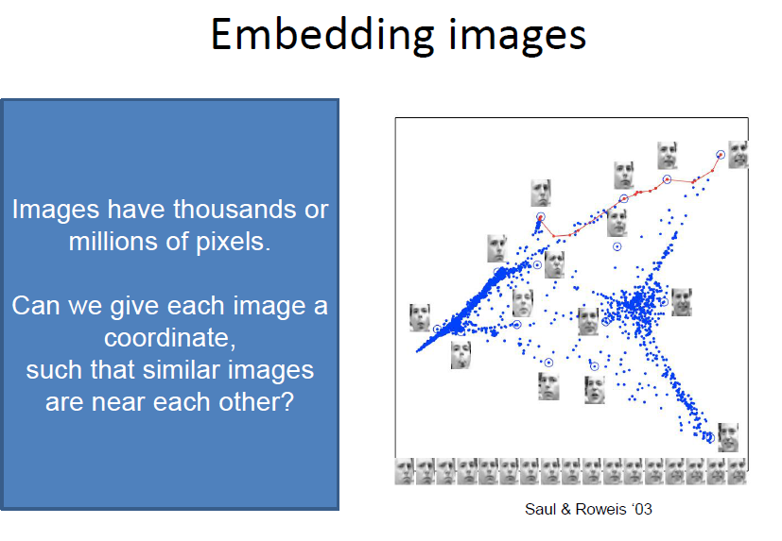

Slide 36
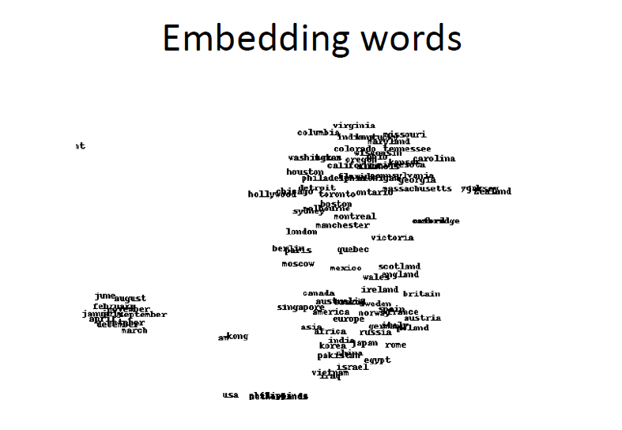

Slide 37

dato-demo-composite-recommender.s3-us-west-2.amazonaws.com/index.html

Slide 38
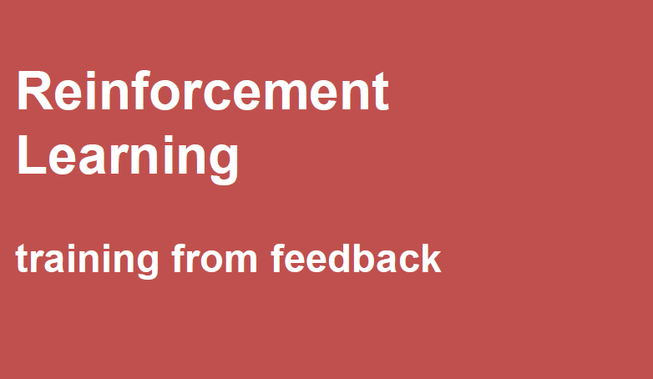

Slide 39
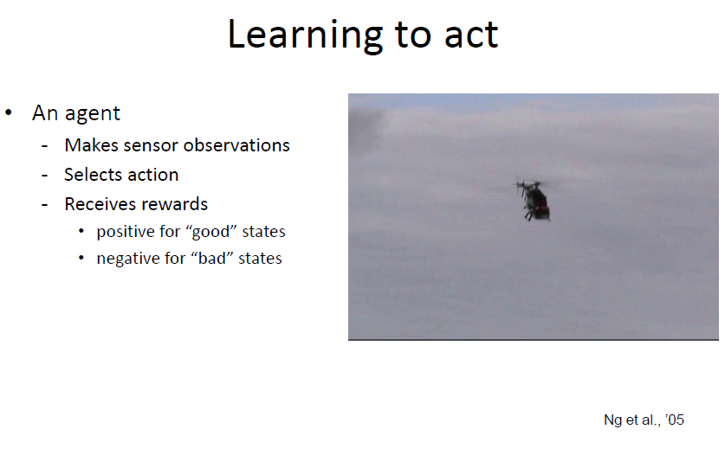

Slide 40
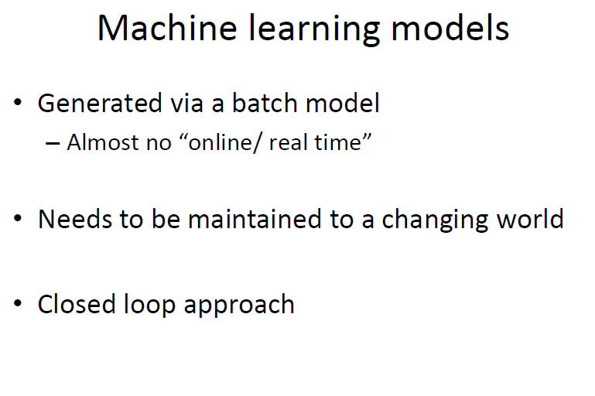

Slide 41
